Slide 1
Final Design Proposal: Red Feather Solar Furnace
Team Red Feather: Nathan Fisher, Leann Hernandez, & Trevor Scott

Slide 2
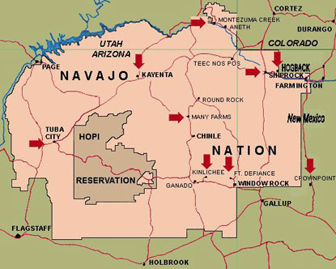
Project Description
Red Feather is a non-profit organization designed to help Native American residents on the Reservation with their housing needs
Residents of the reservation in Northern Arizona originally received coal to heat their homes from the mine supplying Navajo Generating Station, but the plant shut down in 2019.[1]
Burning coal creates respiratory health risks and as a result conditions like asthma are extremely common
The Red Feather Capstone team has been tasked with researching and designing a sustainable solution to heat homes of the Native American people [1]
Solar heaters are renewable and inexpensive long term.
Figure 1: Native American Reservation [1]

Slide 3
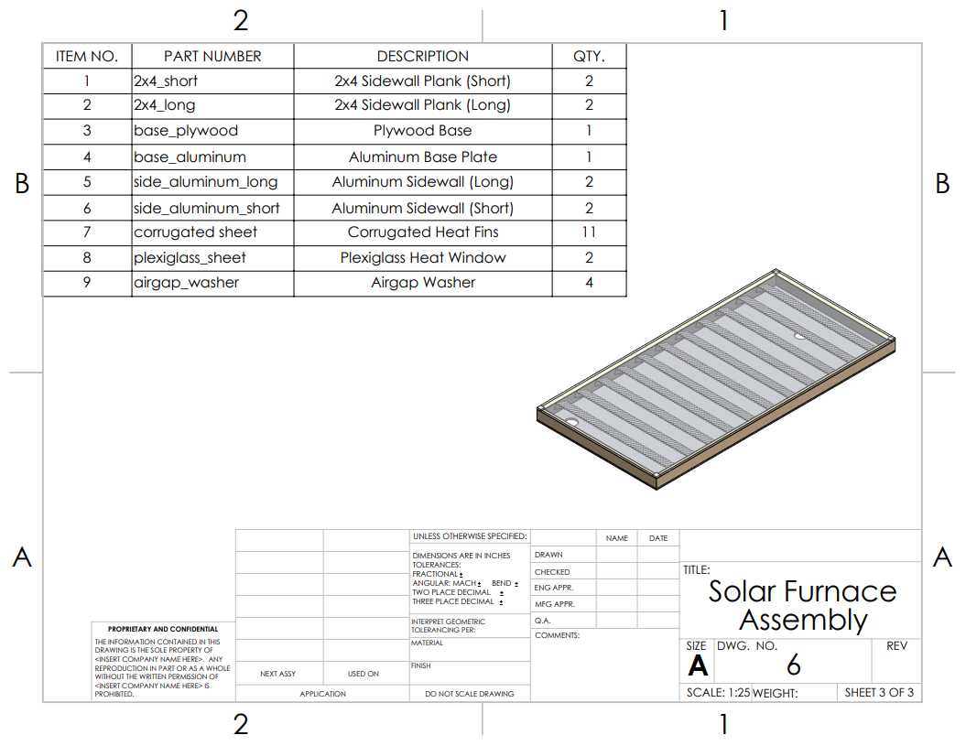
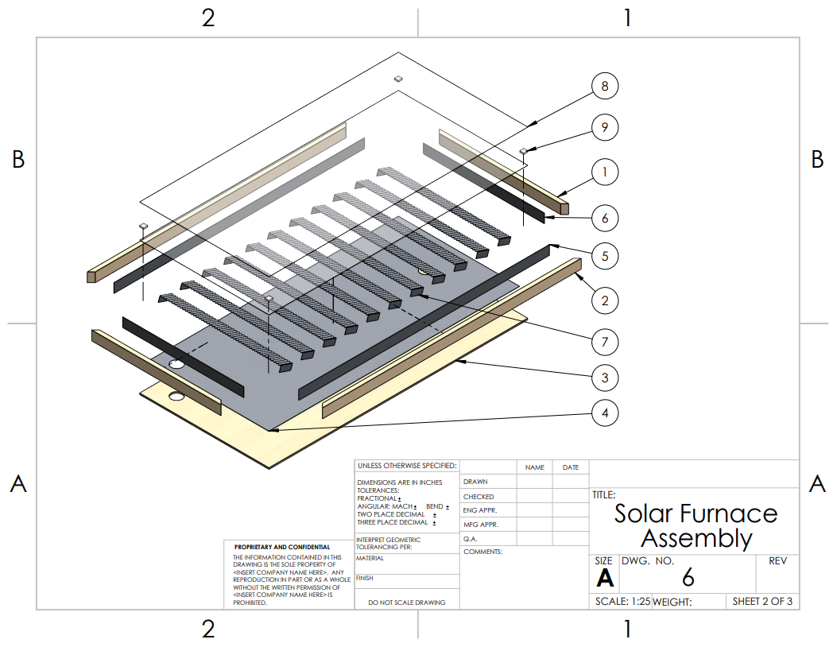
Design Description: Assembly Drawings
Figure 2: Solar Furnace Assembly
Figure 3: Solar Furnace Assembly Exploded View

Slide 4
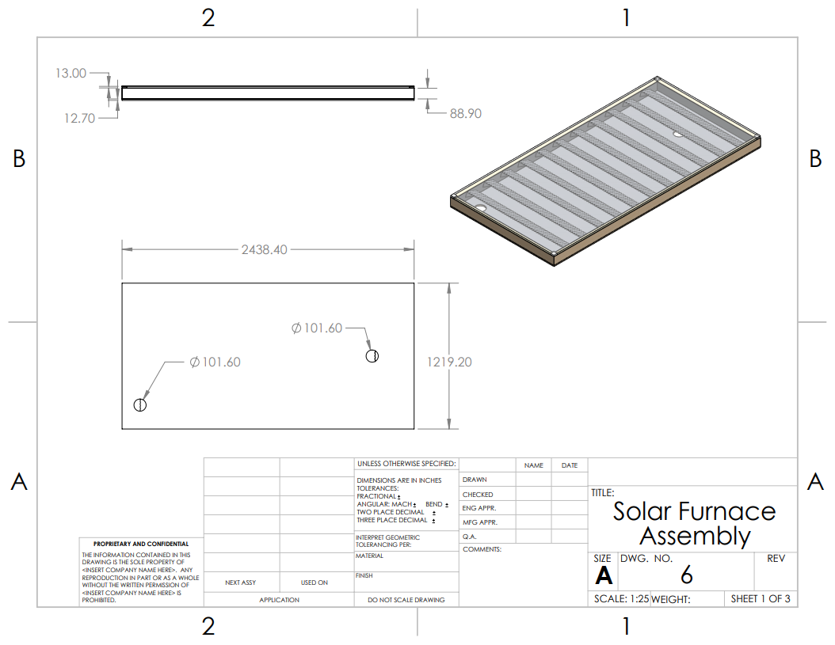
Design Description: Assembly Drawings
The device is 4ftx8ft, and a little under 5in thick.
The current design utilizes 11 evenly spaced corrugated panels, angled 71° from the bottom surface.
Two plexiglass sheets on the front with a 13mm air gap.
Inner casing is lined with a .02in aluminum sheet.
Figure 4: Solar Furnace Assembly Drawing

Slide 5
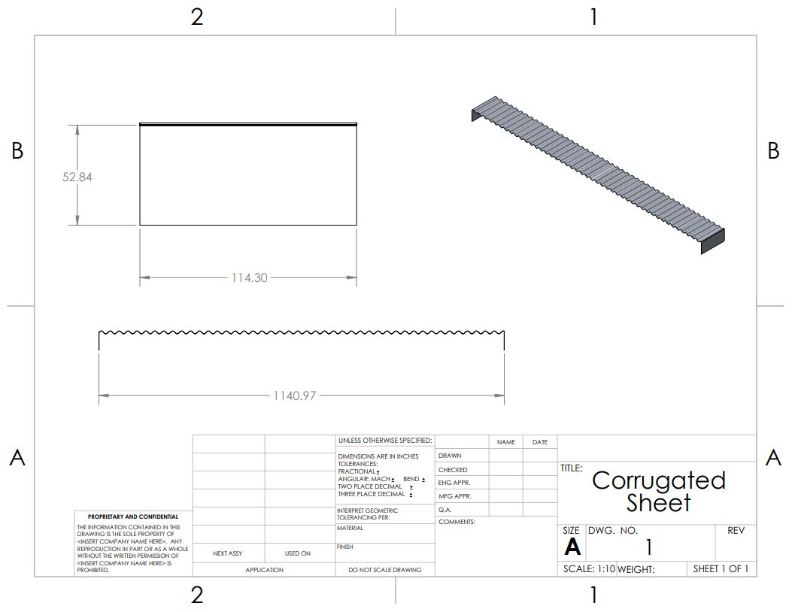
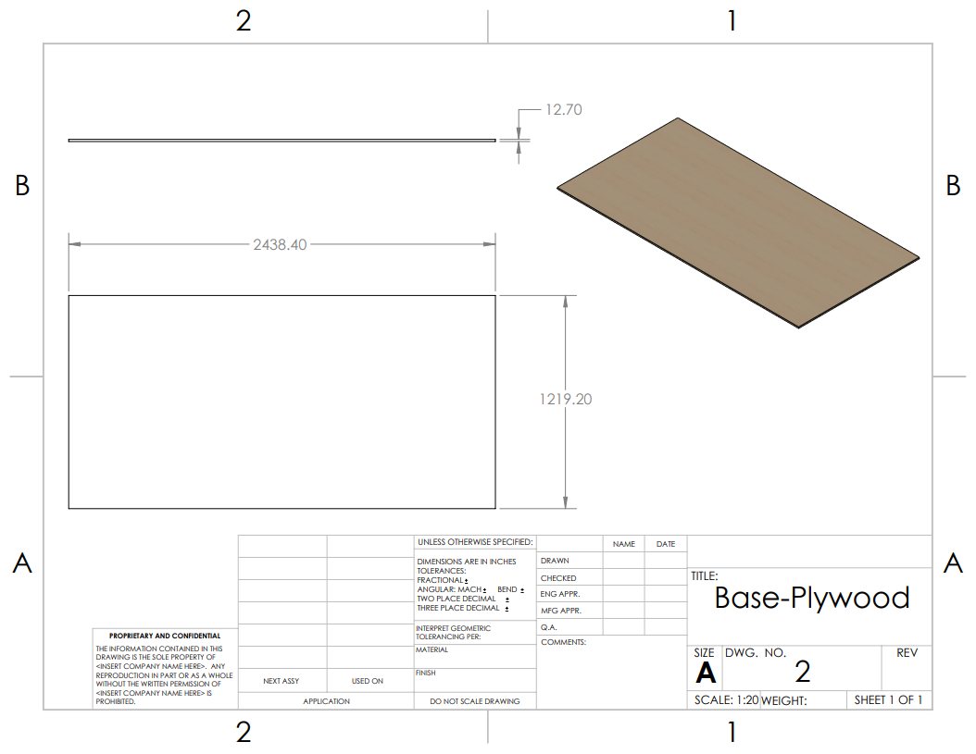
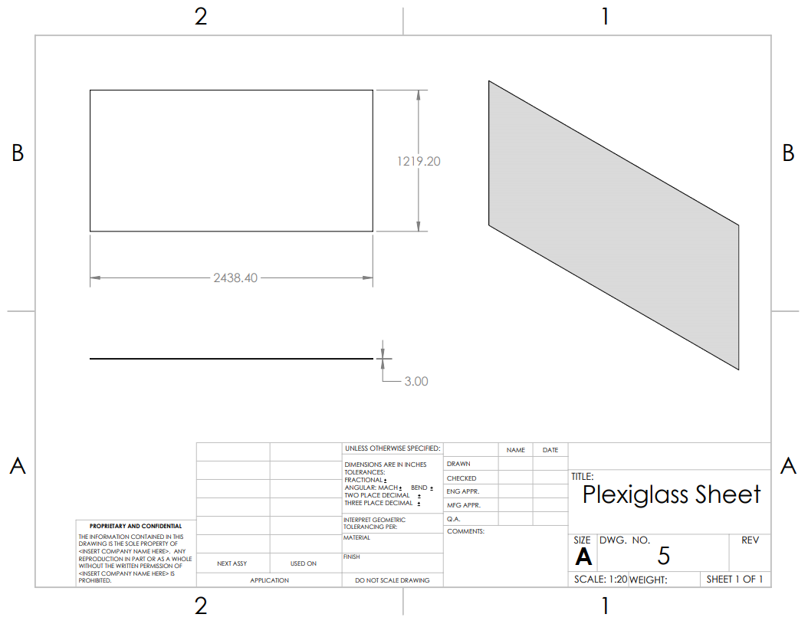
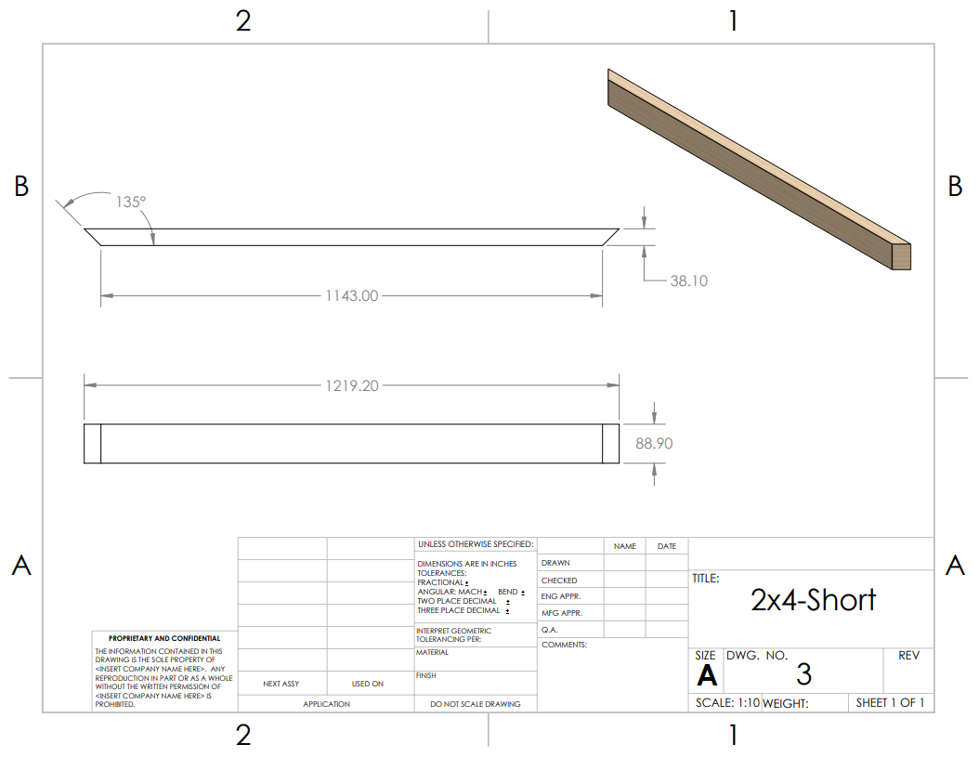
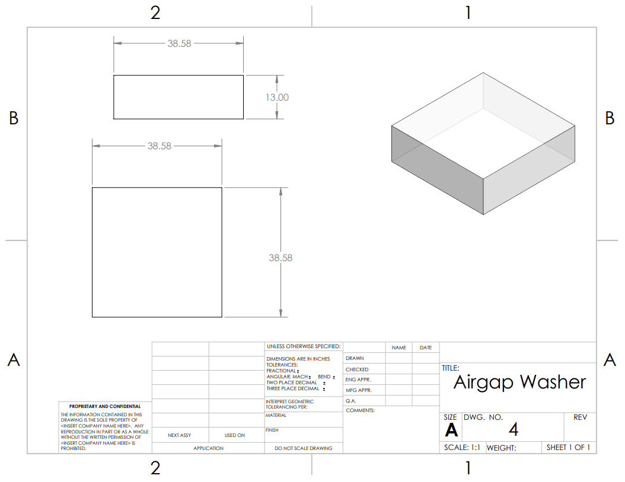
Design Description: Part Drawings
Figure 5: Corrugated Sheet
Figure 6: Base-Plywood
Figure 7: Plexiglass Sheet
Figure 8: 2x4-Short
Figure 9: Airgap Washer

Slide 6
Design Requirements
Primary Engineering Requirement: Produce around 20,000 btu/day
Meets currently used commercial options heat output
Based on analysis from the previous team combined with ours the solar furnace should be able to make at least 22,000 btu/day.
Secondary Requirements:
Installable by two people(W<100lbs): Approximate weight = 60 lbs
Durable: plexiglass, wood, and steel construction with marine fan and outdoor solar panel.
Quiet(dB <40): fan noise 30-40 dB depending on speed chosen

Slide 7
Analysis: Casing Construction (Heat Loss)
There were three distinct casing designs that scored highly on the decision matrix (wood, wood/metal, wood w/ air gap).
Each casing design has a resulting heat loss through its boundaries.
Equations below were used to create resistive heat networks for each design and determine heat loss at the max temperature of the device [2].
The resulting heat losses at a max temperature difference of 50°:
Wood: 34.01W
Wood/metal: 33.99W
Air gap: 27.95W
There is a difference of ~6W between the simple wood casing and that of the air gap; metal made little difference.
1W = 3.4 BTU/hr. The device has a theoretical output of 22000BTU/day, so this loss is negligible compared to construction complexity of an air gap.

Slide 8
Analysis: Heat Transfer Analysis
A heat transfer analysis of the home as a system was conducted to estimate the amount of power the solar furnace needs to produce
The following equation was used to finding the heat loss in a home is shown below where $H_{c}$ is the heat loss due to conduction , A is the surface area, U is the transmission coefficient, and T is the temperature. [2-4]
Similar equations were used to find heat loss through the floor slabs and walls, and from air infiltration. [2-4]
Given the assumptions of a surface area of 600 ft^2, made of wood having a transmission coefficient of 0.20, and being in Flagstaff. The heat loss would be about 843.4 BTUH as a conservative estimate.
Adding more assumptions such as metal frame windows, a non-weatherstripped door, opening the door a couple times a day, and wind at 10 mph. The heat loss would be about 9,106 BTUH as a conservative estimate
The total heat loss in a home on the Native American reservation would be around 10,000-16,267 BTUH

Slide 9
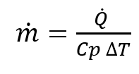
Analysis: Fan Sizing + optimization
Most solar furnaces aim for an increase of temperature of at least 50° F.
This is primarily because customers prefer to be able to feel hot air coming out of the furnace outlet.
Energy analysis shows that if the outlet temperature is at least the desired indoor temperature the furnace will work. This is because the same amount of energy, is ultimately being convected into the home. [6]
A faster flowrate lowers the ΔT but slightly increases efficiency of the furnace due to less heat being able to escape before entering the house.
Using the desired ΔT the mass flowrate can be found using [2]
Then flowrate can be found using
The flowrate is the found to be around 0.0477 m³/s or 101 cfm

Slide 10
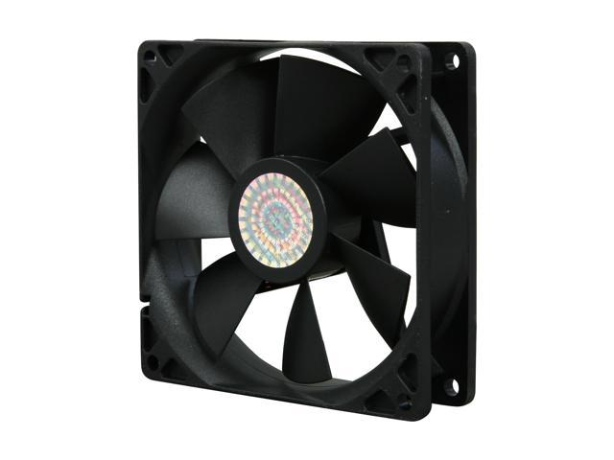
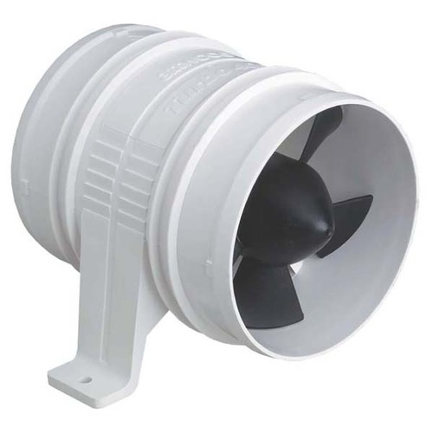
Design Validation
$10
Risk Analysis found the main potential failure of the device to be the fan as it’s the only non-passive component.
To accommodate for this potential failure a high-quality marine blower fan will be used in the design.
Increase in price but worth increase in lifespan and decrease in maintenance.
Figure 10: Computer Fan with Desired Flowrate [7]
$30
Figure 11: Boat Bilge Blower [8]

Slide 11
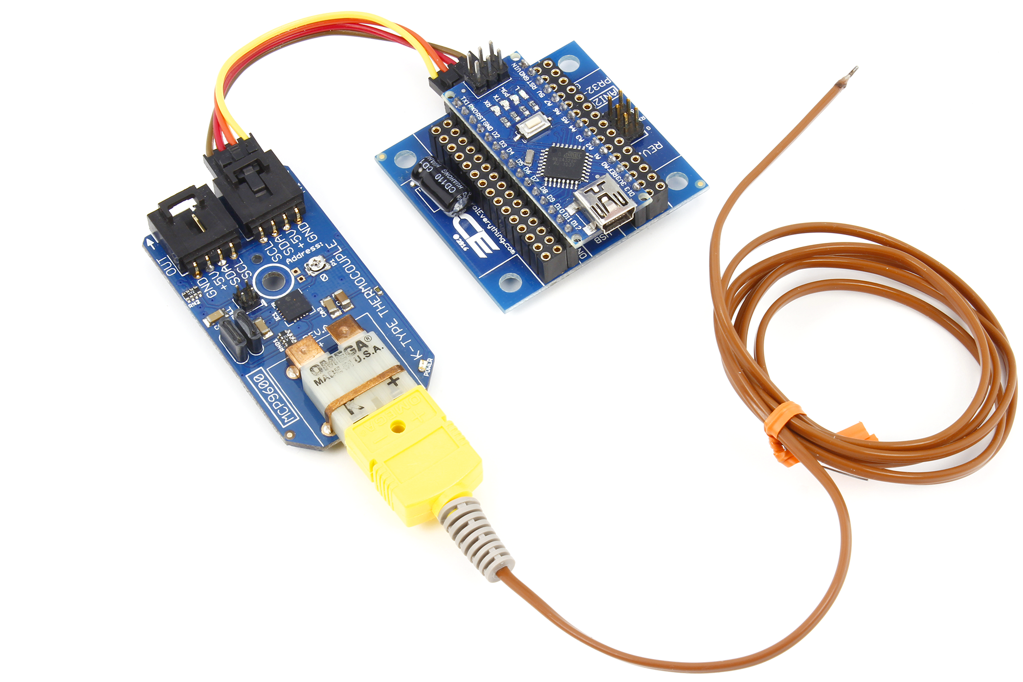
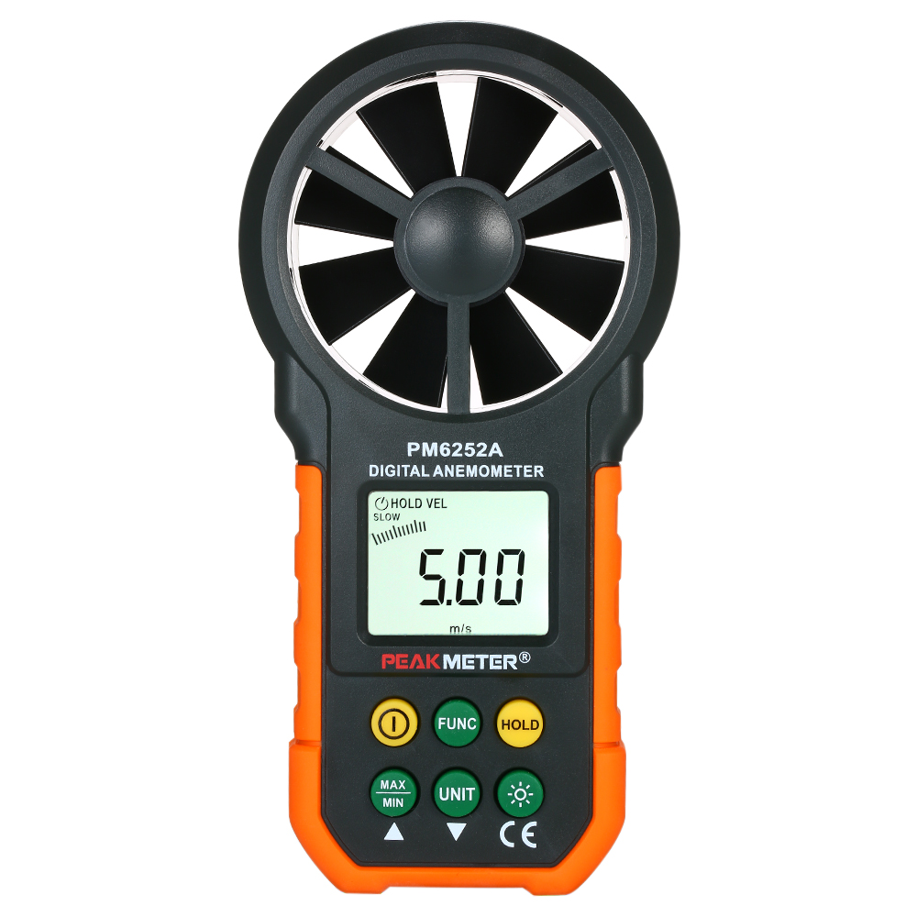
Design Validation
Output air temperature and flow rate will be measured to find the net heat output of the device.
Temperature with Arduino Thermocouple
Air flow with anemometer
Test will be completed in Flagstaff at several times.
Mid-morning, noon, and afternoon.
Flagstaff replicates use on the reservation well.
Figure 12. Arduino Thermocouple with K type Thermocouple​ [9]
Figure 13. Digital Anemometer [10]​

Slide 12
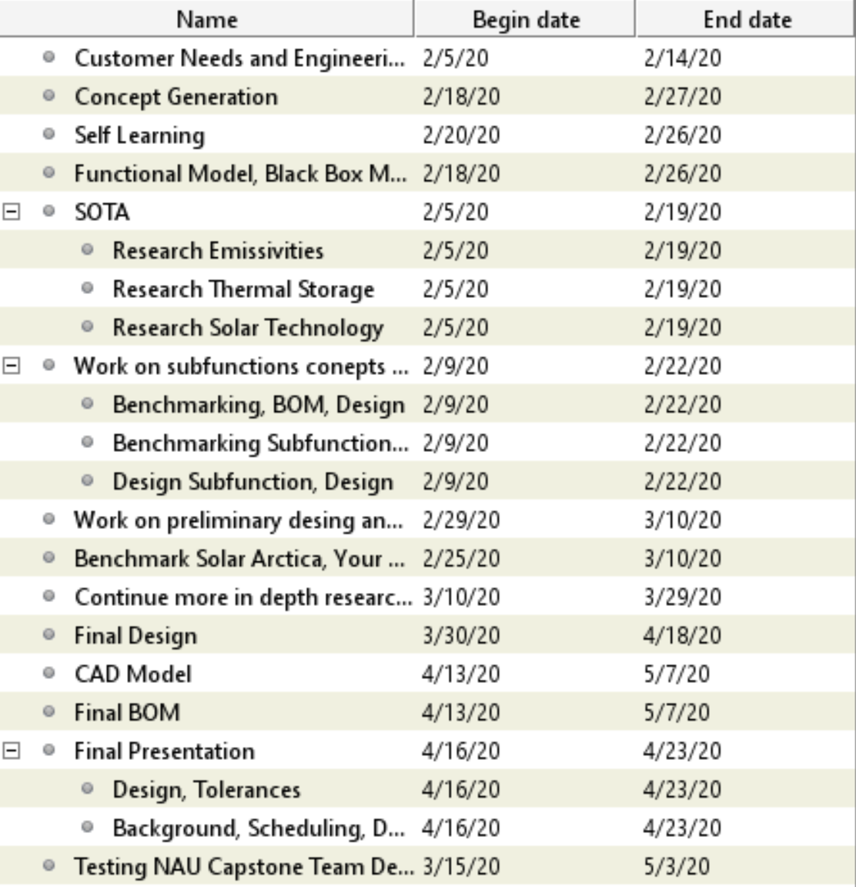
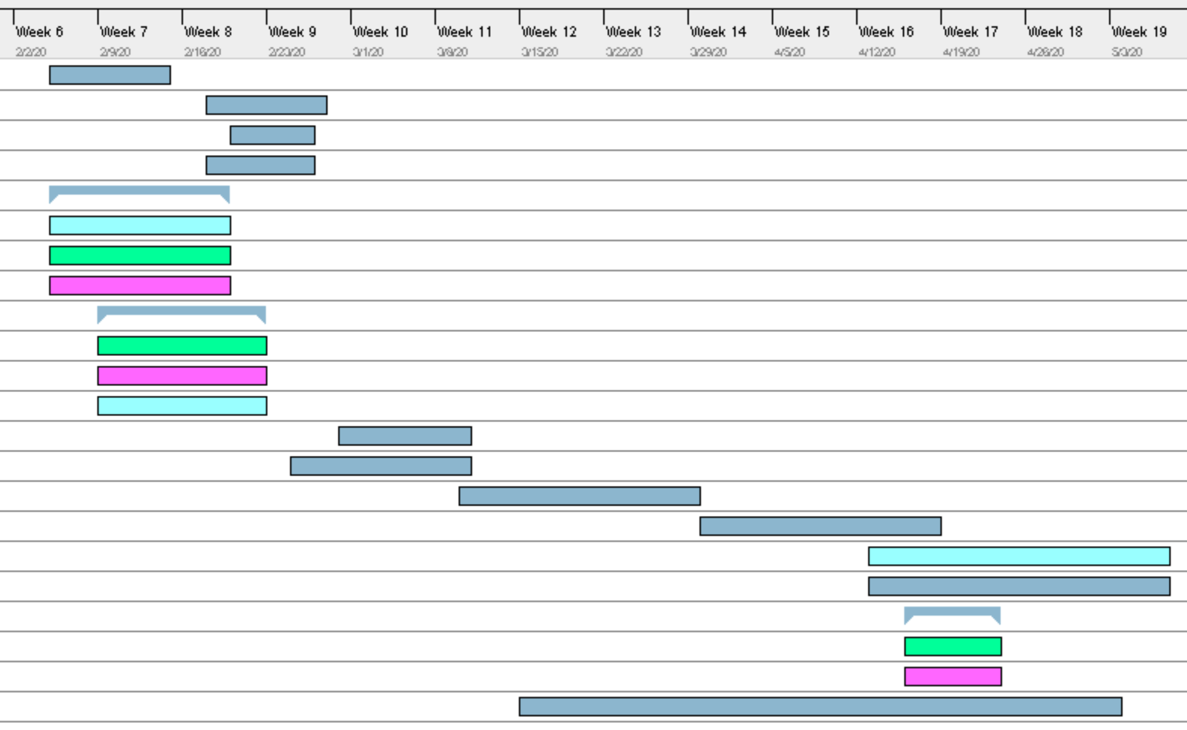
Schedule
Table 1: Semester 1 Tasks
Legend
Leann
Nathan
Trevor
Everyone
Figure 14: Semester 1 Gannt Chart [11]
The semester schedule is shown in the Gannt Chart Above
Testing and prototype building has been moved to next semester due to delays from COVID-19
This makes the team behind schedule

Slide 13
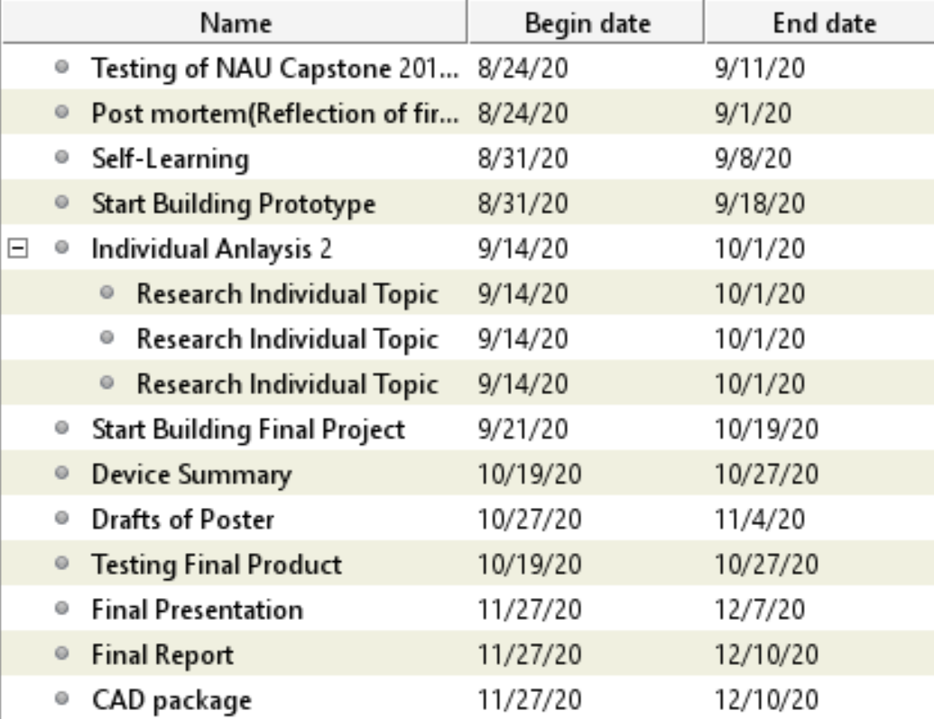
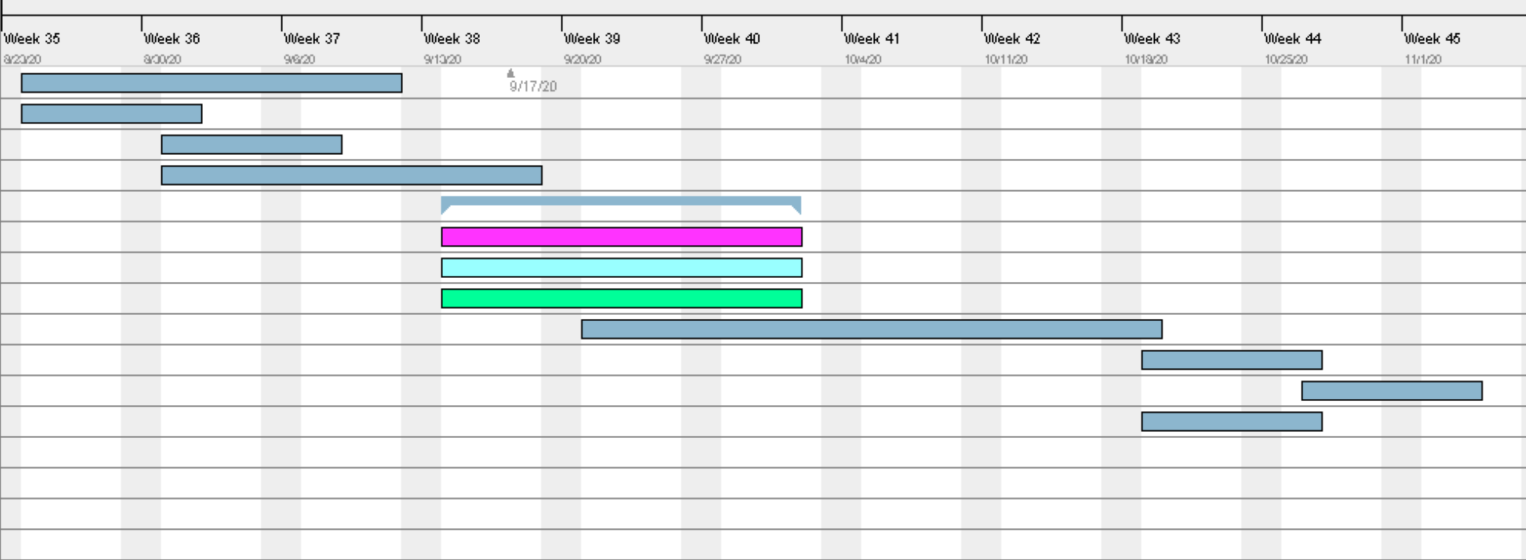
Schedule
Table 2: Semester 2 Tasks
Legend
Leann
Nathan
Trevor
Everyone
Figure 15: Semester 2 Gannt Chart [11]
Semester 2 will start testing designs from NAU Capstone 2018-2019 and other solar panels
The prototype and final project will be built
The device summary, posters, testing of final project, and final report are scheduled for semester 2

Slide 14
Budget: BOM
Table 3: Bill of Materials
The current bill of materials for the 4 ' x 8' solar furnace results in a total cost of about $440.
This is about half of what the previous capstone team found and a quarter the cost of the Your Solar Home product.
The main savings are from replacing the glass with plexiglass and making the frame a composite of wood with aluminum sheets rather than a machined aluminum box.

Slide 15
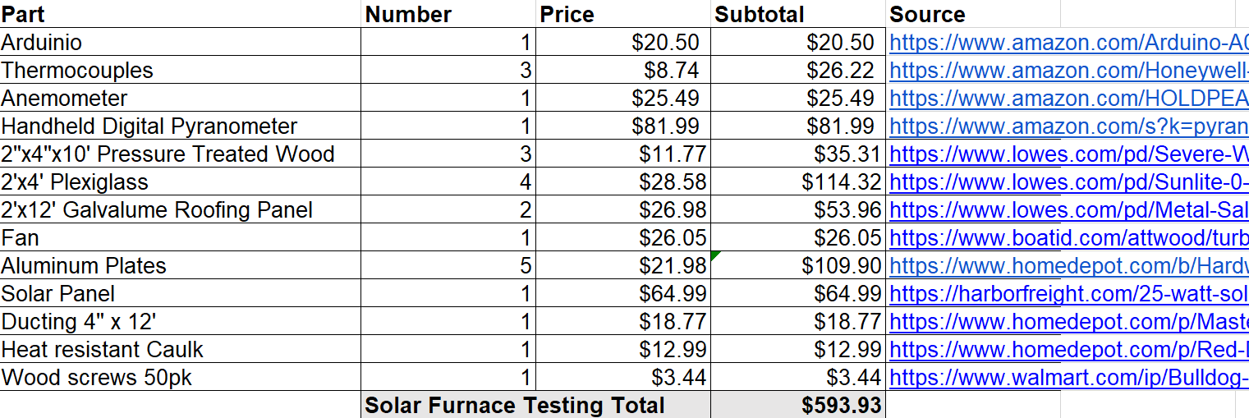
Budget: BOM (w/ test materials)
Table 4: Bill of Material with Testing Materials
The anemometer would be used to test the fan speed while the pyranometer would measure the solar irradiance
The thermocouples would be used to measure the inner and ambient temperature during the testing process
The testing by itself would cost about $154.20
The testing materials bring the total cost of the solar furnace project to $593.93

Slide 16
References
[1] “Red Feather Solar Furnace 2,” Northern Arizona University, Jan-2020. .
[2] F. P. Incropera, T. L. Bergman, D. P. Dewitt, and A. S. Lavine, Incroperas Principles of Heat and Mass Transfer. John Wiley & Sons, 2017.
[3] “Heat Loss in PV Modules,” PVEducation. [Online]. Available: https://www.pveducation.org/pvcdrom/modules-and-arrays/heat-loss-in-pv-modules. [Accessed: 30-Mar-2020].
[4] J. Marsh, “How Hot Do Solar Panels Get? PV Temperature Explained: EnergySage,” Solar News, 01-Aug-2019. [Online]. Available: https://news.energysage.com/solar-panel-temperature-overheating. [Accessed: 30-Mar-2020].
[5] M. D. Egan, Concepts in thermal comfort. Englewood Cliffs, NJ: Prentice-Hall, 1975.
[6]“Sizing Fans and Ducting for Solar Air Heating Collectors,” Sizing Fand and Ducting for Solar Air Heating Collectors. [Online]. Available: https://www.builditsolar.com/Projects/SpaceHeating/FanSizing/FanSizing.htm. [Accessed: 28-Mar-2020].
[7] “OD1238-12HB-ORIN,” Orion - Axial Fans | Galco Industrial Electronics. [Online]. Available: https://www.galco.com/buy/Orion/OD123812HB?source=googleshopping&utm_adgroup=&msclkid=8471ebaf6ea417350ac6b52e57b8d713&utm_source=bing&utm_medium=cpc&utm_campaign=Shopping - Part Numbers - B&utm_term=4580428003235509&utm_content=other manufacturers. [Accessed: 30-Mar-2020].
[8] “Attwood Turbo Inline Bilge Blower” Wholesale Marine. [Online]. Available: https://www.wholesalemarine.com/attwood-turbo-in-line-bilge-blower-78937.html
[9 ]“Arduino K type thermocouples,” NCD [Online]. Available: https://ncd.io/k-type-thermocouple-mcp9600-with-arduino/
[10] “Digital Wind Anemometer". [Online]. Available: https://www.walmart.com/ip/Wind-Thermometer-Meter-Outdoors-PEAKMETER-CFM-Fishing-Gauges-Sailing-Backlight-Speed-Data-Anemometer-Air-LCD-Surfing-Weather-Portable-Collection-Hand/984442297?wmlspartner=wmtlabs&adid=22222222222299092587&wmlspartner=wmtlabs&wl0=e&wl1=o&wl2=c&wl3=74904344636201&wl4=pla-4578503890345144&wl5=&wl6=&wl7=&%20wl10=Walmart&wl12=984442297_10001020730&wl14=anemometer&veh=sem
[11] “GanntProject.biz,” GanntProject.biz. Accessed: January 24, 2020

